Slide 1
Inferential Statistics

Slide 2
Understanding Probability
Exploring the role of probability in inferential statistics.
Probability forms the foundation for making inferences about populations based on sample data.

Slide 3
Sampling Distributions
Diving into the world of sampling distributions and their importance in inferential statistics.
Understanding how sample statistics can be used to make inferences about a population.

Slide 4
Central Limit Theorem
Exploring the fundamental principles of the central limit theorem and its role in inferential statistics.
Understanding how it enables making inferences about a population from a sample.

Slide 5
Confidence Intervals
Mastering the concept of confidence intervals and their role in estimating population parameters.
Learning how to interpret and construct confidence intervals.

Slide 6
Hypothesis Testing
Unraveling the significance of hypothesis testing in inferential statistics.
Understanding how to formulate and test hypotheses to make informed decisions.

Slide 7
Inferential Statistics in Research
Applying inferential statistics in research settings.
Understanding how these techniques are used to draw conclusions and make predictions based on data.

Slide 8
Real – World Applications
Exploring real-world applications of inferential statistics in various fields such as business, healthcare, and social sciences.
Understanding how these insights drive decision-making.

Slide 9
Challenges and Limitations
Addressing the challenges and limitations of inferential statistics.
Understanding the potential pitfalls and considerations when drawing inferences from data.

Slide 10
Conclusions
In conclusion, mastering inferential statistics is essential for drawing meaningful insights from data.
Embracing the principles discussed in this presentation will empower you to make informed decisions based on data-driven evidence.

Slide 11
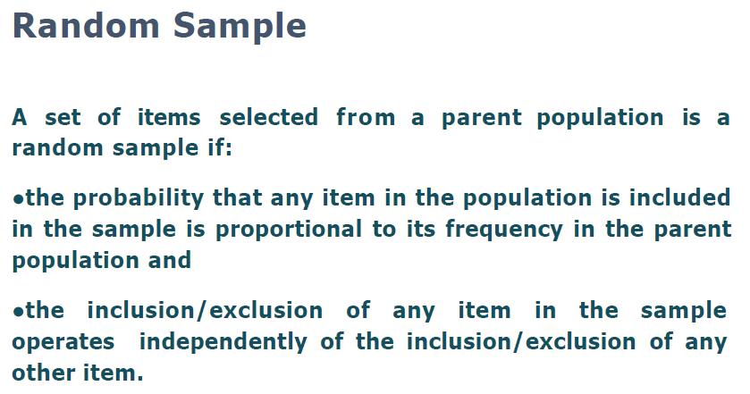
Sampling & Statistical Inference

Slide 12
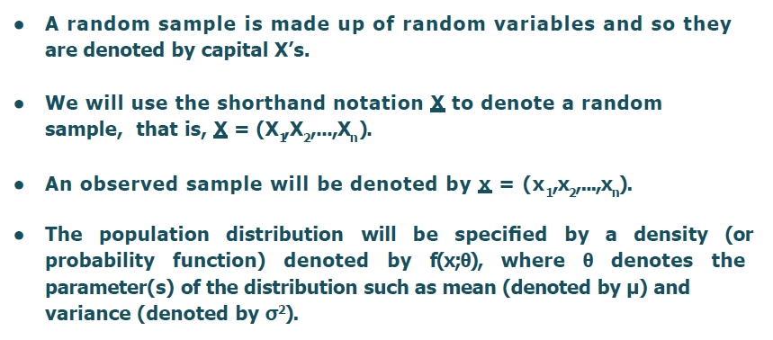
Random Sample Notation

Slide 13
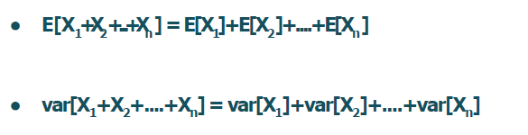
Sum of Independent R.V

Slide 14
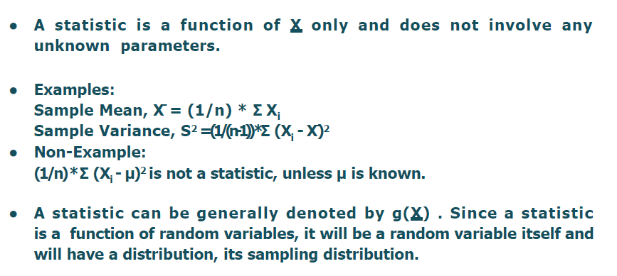
Definition of Statistic

Slide 15
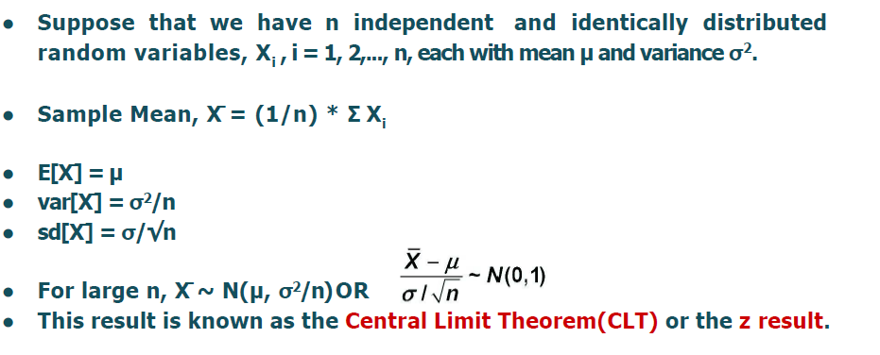
Sample Mean
Any function that has random sample value associated would become your statistics

Slide 16
Central Limit Theorem
Central limit theorem says that if we repeatedly take random samples from any population the distribution of their means will tend to be normal (bell-shaped) as the sample size increases and it is independent of the population's original distribution.
these averages will tend to form a normal distribution.
This normality holds true as long as the sample size is sufficiently large typically n≥30 providing the foundation for making inferences about populations even when we don’t have access to all the data.
When you have a population where the data follows some random variable X and this population has:
Mean μ the average of the population
Standard deviation σ

Slide 17
Random sample is combination of different random variable
It follow two conditions which we saw in earlier slide.
Once we study random sample, we will study about statistics value
Any function called statistics but there is a limit of X Bar which is unknown.
So according to CLT if we have idea about population mean and standard deviation and large sample tend to become a normal distributions and we can find out the sample mean X bar.
If I would like to standardize it then we are using the equation
And if I made standard normal distribution of data then I know the Z Value
So I can relates Z Statistics to the probability
So if Population variance is unknown in Z Statistics then we are using other distribution to find out the probability
Like if we don’t k now the Population variance then we are using T test
Then we are not converting normal distribution to standard normal distribution

Slide 18
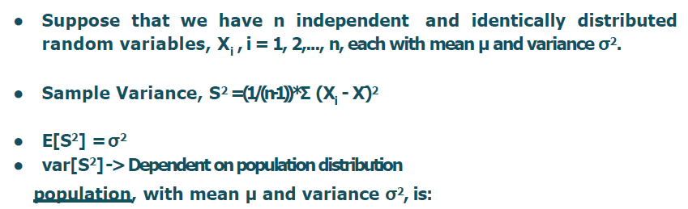
Sample Variance

Slide 19
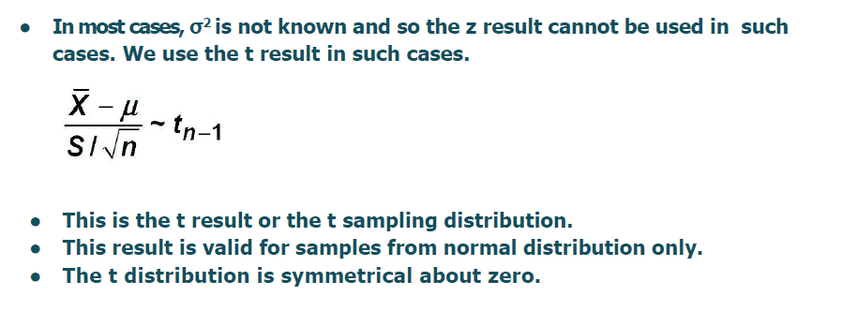
T Test

Slide 20
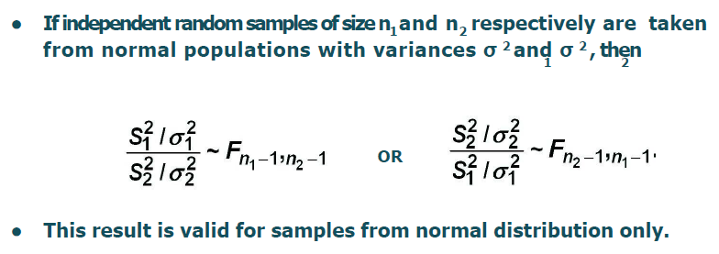
F Test

Slide 21
Point Estimation
In statistics, point estimation involves the use of sample data to calculate a single value which is to serve as a "best guess" or "best estimate" of an unknown population parameter.
Point estimation will give you the exact value where Interval estimation will give you the range of the value.
Point estimation as of no use although one of the point estimation that it the method of maximum likelihood use in machine learning later

Slide 22
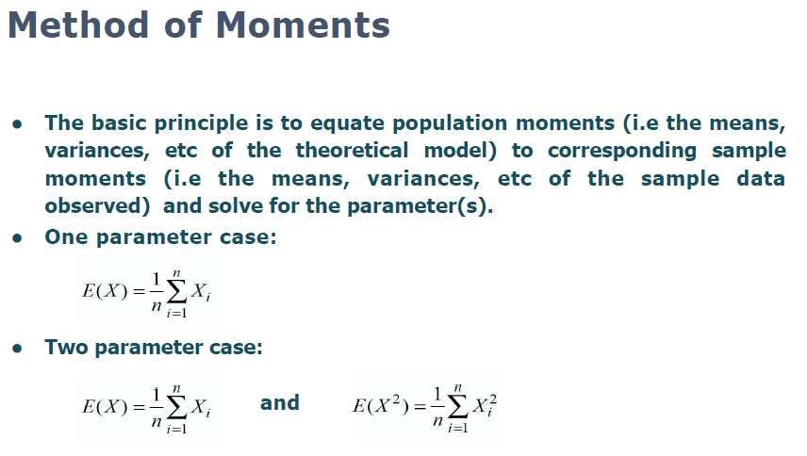

Slide 23
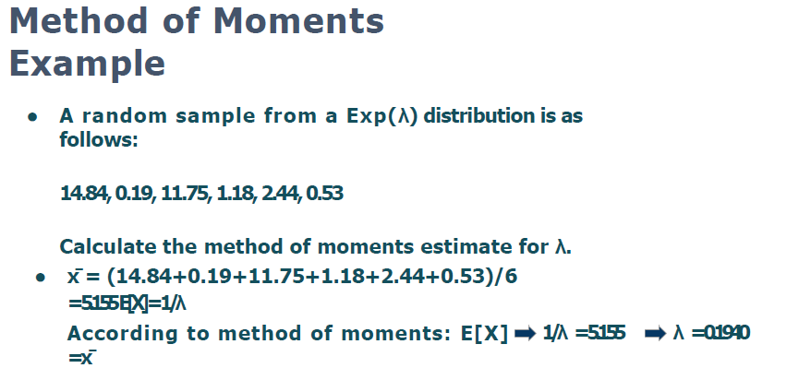

Slide 24
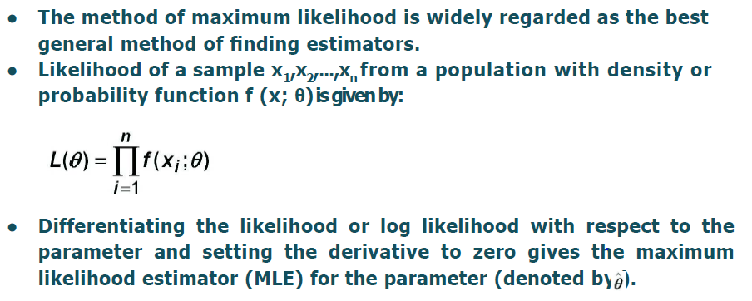
Method of Maximum Likelihood

Slide 25
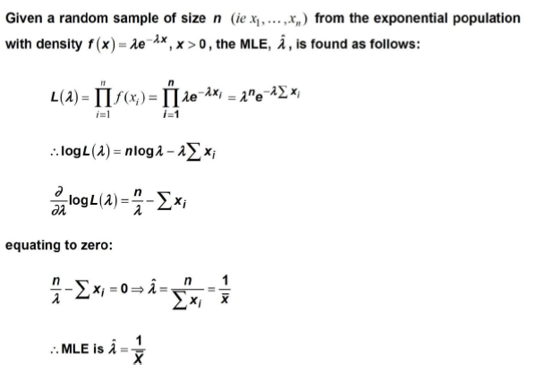
Example

Slide 26
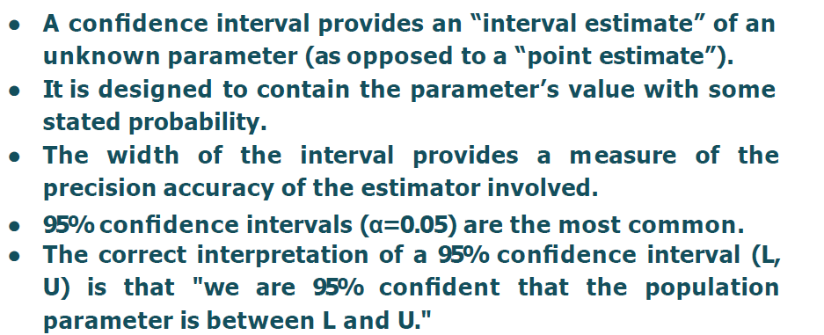
Confidence Intervals

Slide 27
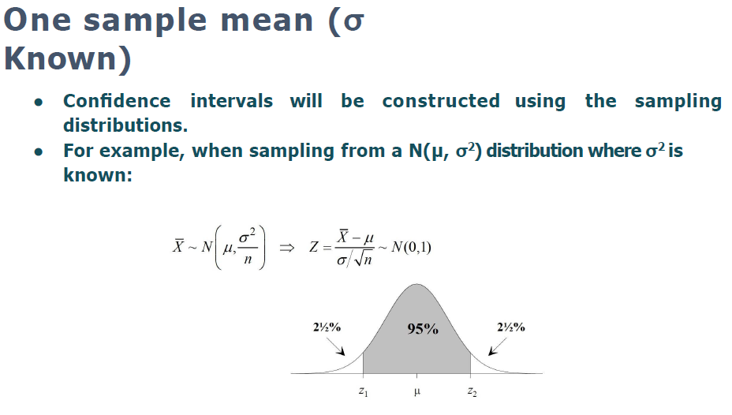

Slide 28
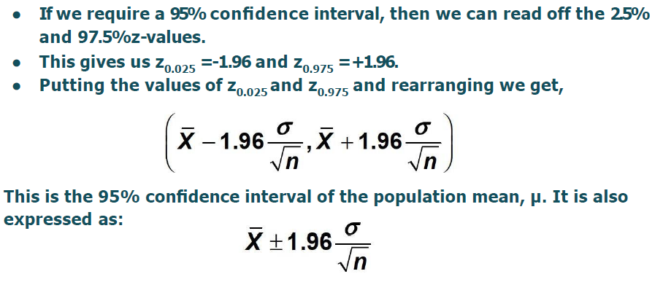

Slide 29
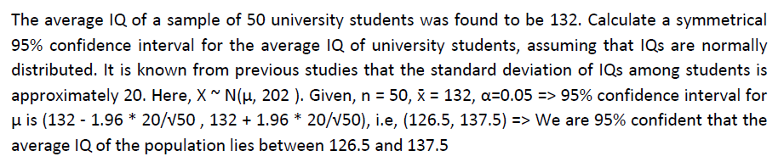
Example

Slide 30
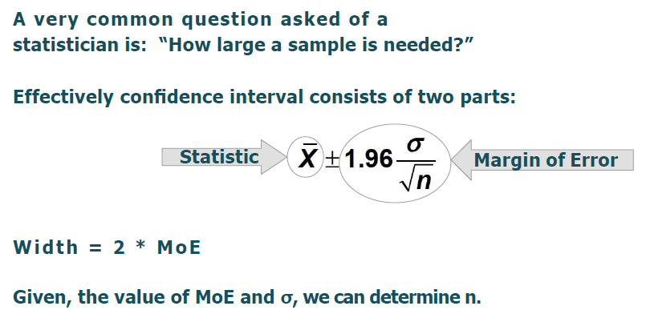
Finding Sample Size

Slide 31
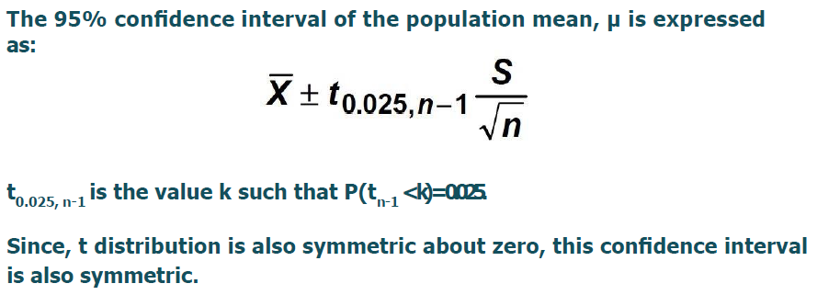
One Sample Mean (Sigma Unknown)

Slide 32
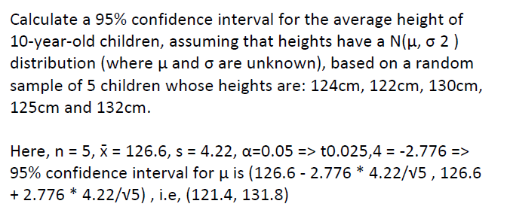
Example

Slide 33
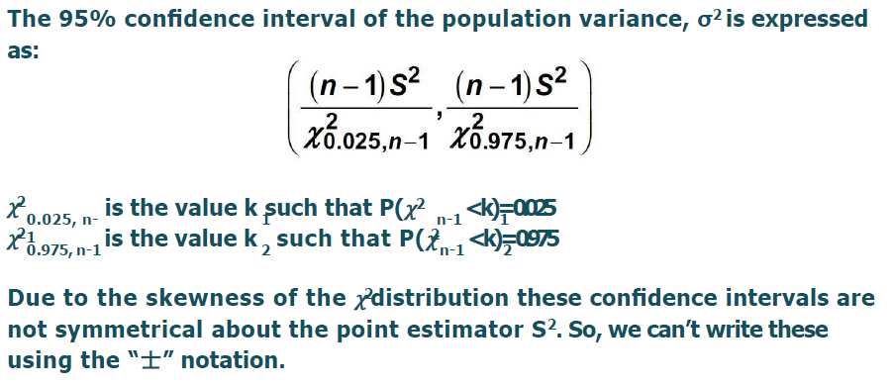
One Sample Variance

Slide 34
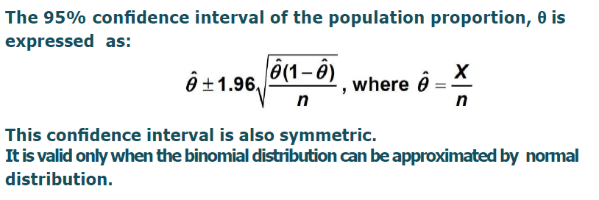
One Sample Proportion

Slide 35
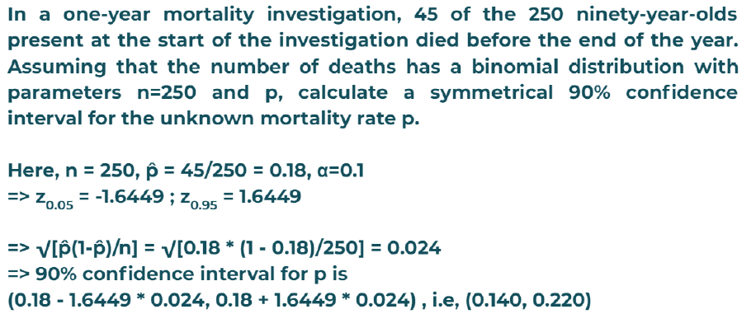
Example

Slide 36
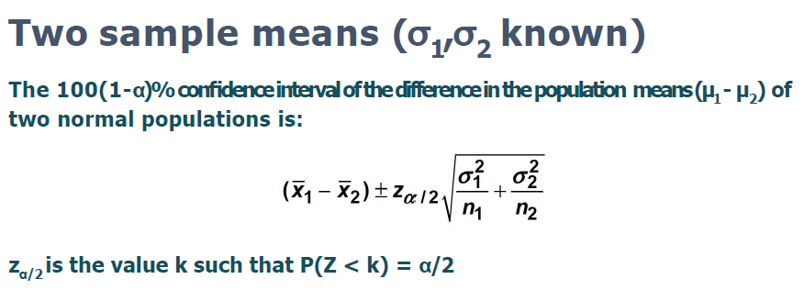

Slide 37
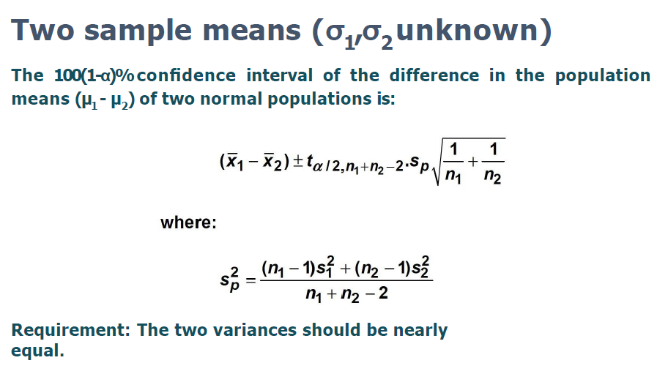

Slide 38
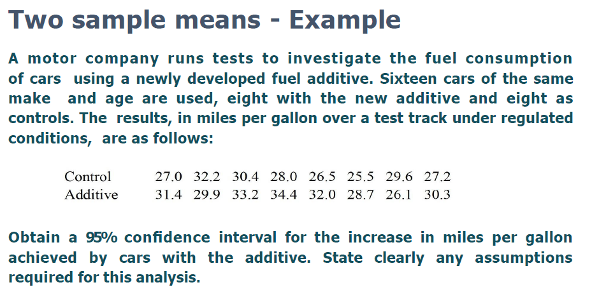

Slide 39
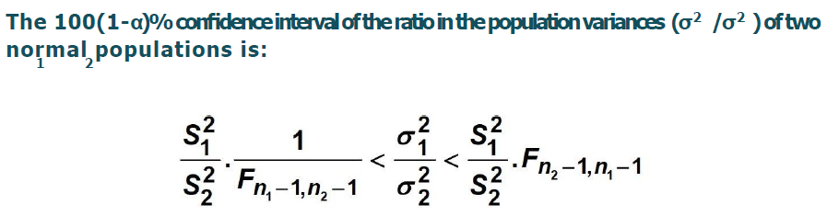
Two Sample Variances

Slide 40
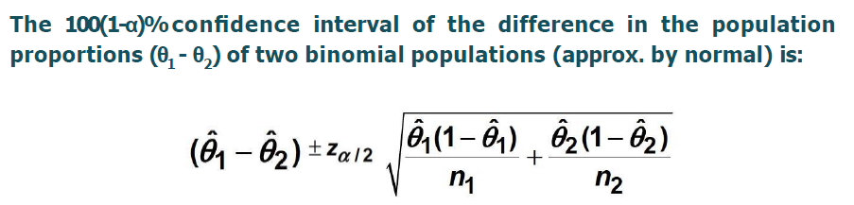
Two Sample Proportions

Slide 41
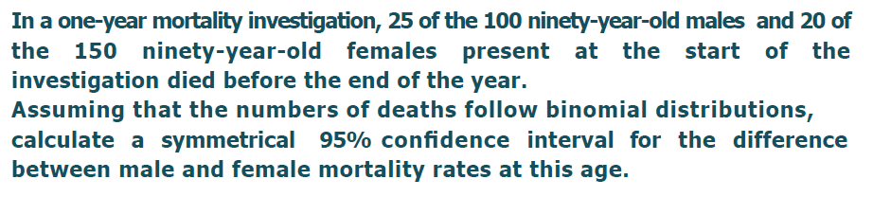
Example

